Slide 1
Microsoft Endpoint Configuration Manager Dashboard

Slide 2

Product Overview
Customer Profile
Value Proposition
Strategic Features
Offering Package

Slide 3

Customer Challenges
Our customers are looking for ways to visualize data in a comprehensive way.
Microsoft Endpoint Configuration Manager has incredible amount of valuable data, but our customers are unable to find ways to get that data to a usable format or not aware it is even there. Our engineers and consultants work on these challenges all the time. We have the capabilities to get this information created but most of our customers do not. This dashboard can be used to solve those challenges.

Slide 4

Customer Story
One of our customers implemented this dashboard and was able to find a problem with their Windows 10 deployment minutes after reviewing the dashboard. It turned out that some one had changed the Task Sequence in Configuration Manager for the Windows 10 image to Education edition instead of Enterprise. This was would have caused them to have to fix all their deployments, but we were able to correct it after the first 30 endpoints were reimaged.

Slide 5

Customer Story
Another one of our customers uses these data to present progress to upper management from the Information Technology department on how deployments are going. They also use the dashboard for identifying software licensing needs and tech refreshes.

Slide 6
Value Proposition
PRODUCT
CUSTOMER
Benefits
Simple
Experience
User Experience
Customization
Features
Software Usage Review
Patch Compliance
Single location
Ease of learning
Forecasting
Application Deployment Summary
Hardware Compliance
Wants
Easy Access
Fears
Security Compliance
Needs
Forecasting
Hardware Compliance
Simplicity
Single System
Wasteful spending on software/hardware
Software Inventory
Gaps in their environments

Slide 7
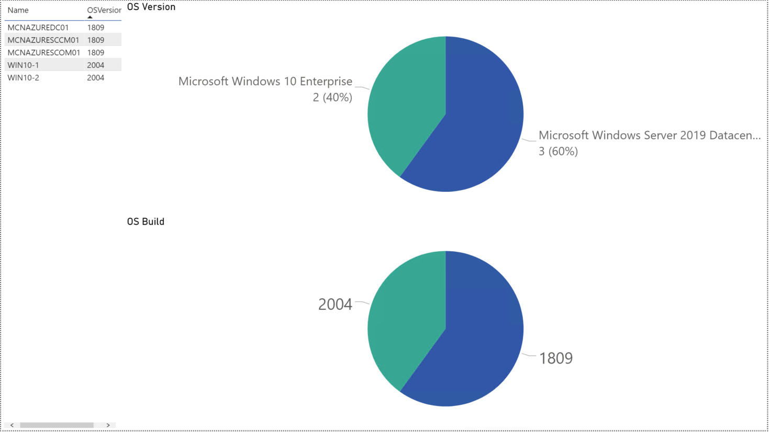
Security Compliance – Operating System
Tracking Operating System deployments
Locating systems that are noncompliant for operating system version and build number
Filtering server and workstation operating systems

Slide 8
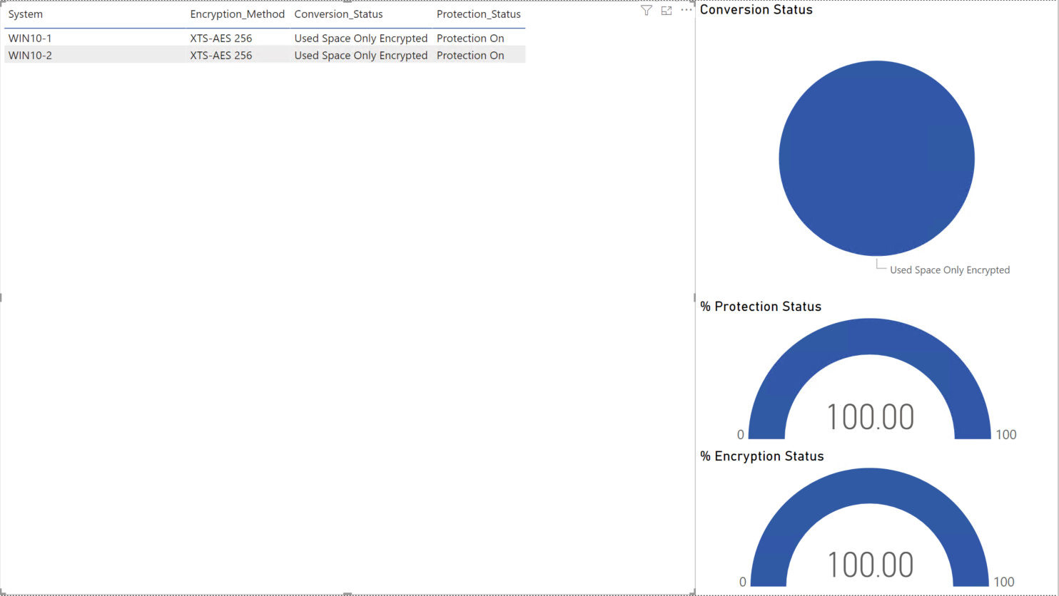
Security Compliance - Bitlocker
BitLocker compliance for your endpoints for the following items:
Conversion Status
Protection Status
Encryption Status

Slide 9
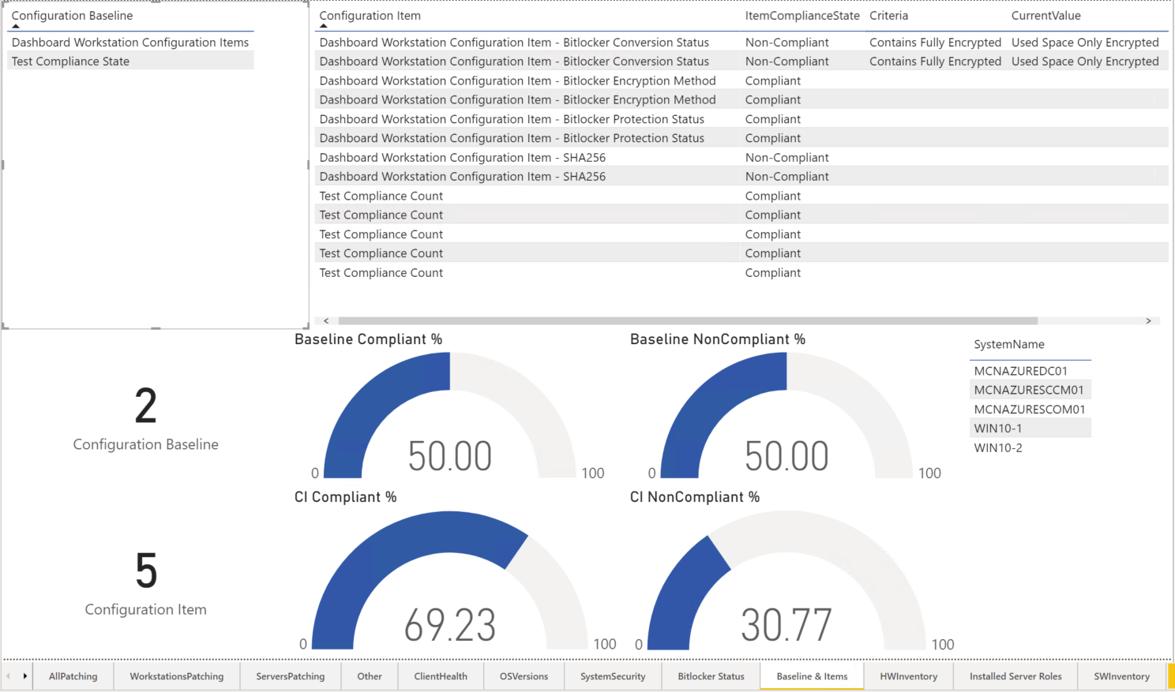
Security Compliance – Configuration Baselines and Items
Compliance checks on systems for deployed Configuration Baselines with details of each Configuration Item
Tracking specific system compliance for a Configuration Baseline or Configuration Item

Slide 10
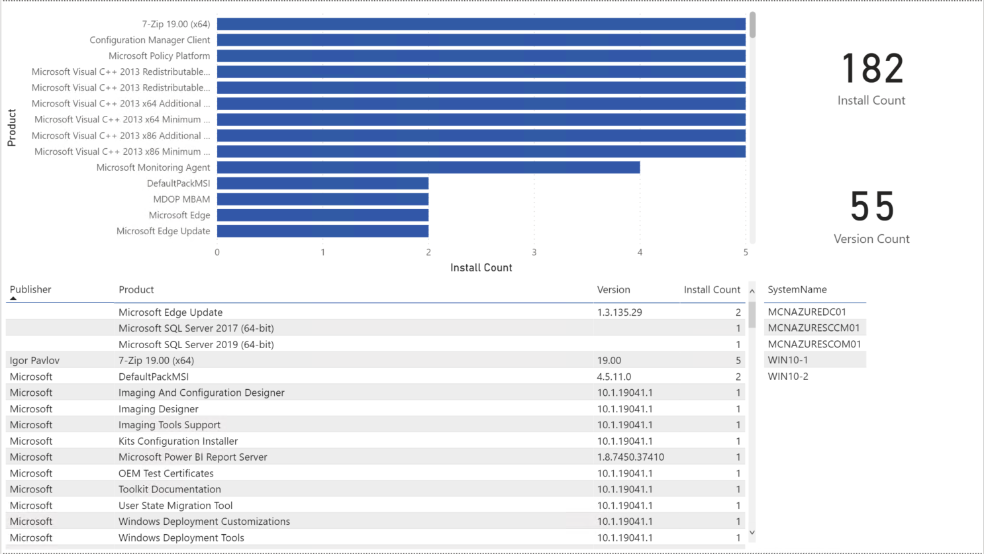
Software Inventory
Review software that was detected on your systems
Build AppLocker allow and deny lists off corporate policies
Detect outdated software that needs to be replaced or upgrade

Slide 11
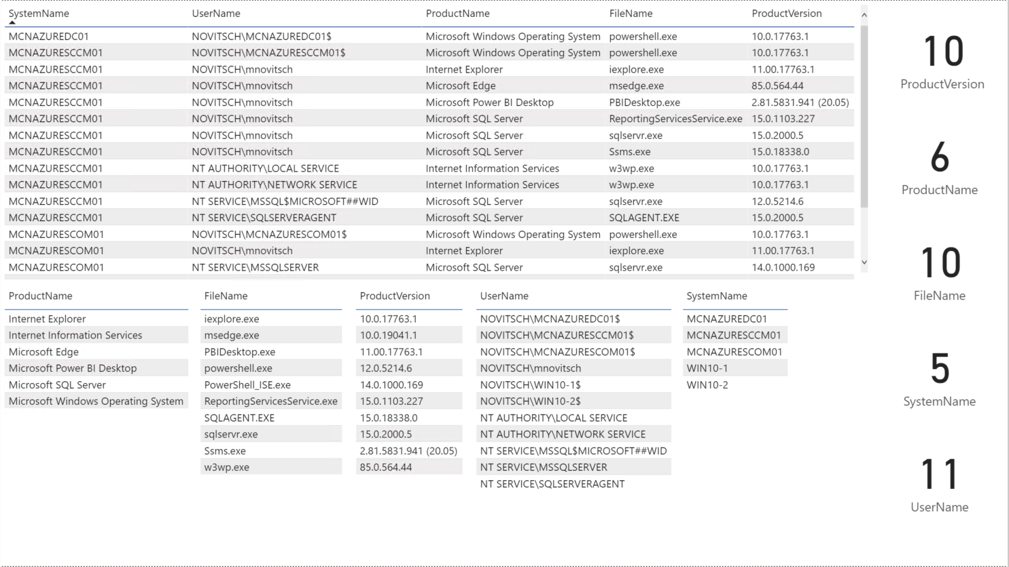
Software Usage
Detect software that is used on your endpoints and the account running it
Compare to your licensing system for annual true-up
Review service accounts running software on servers

Slide 12
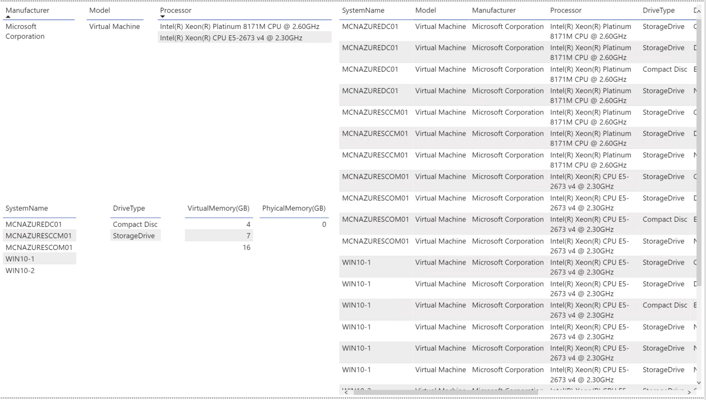
Hardware Inventory
Plan for hardware refresh cycles with what is deployed in your corporation
Determine hardware upgrades for system with count
Detect USB storage media attached to systems

Slide 13

Additional Features
Client Health
Installed Server roles across your environment
Installed MECM Server Roles in your MECM Environment
Collection dashboard
Default Hardware Inventory classes and Custom Hardware Inventory classes
List of Maintenance Tasks and schedules
Application Summary

Slide 14

Questions?

Slide 15

References
https://github.com/mattnovitsch/MECM/wiki/MECM-Administrator-Dashboard

Slide 16

Thank you

